Slide 1

IDS517 HW7:
Self Information Webpage
Shree Parida
UIN: 659199283
sparid3@uic.edu

Slide 2
Introduction
Six sections have been included here:
About
Home
Education
Experience & Skillset
Hobbies
Contact
The assignment consists of 3 files: index.htl, style.css, script.js
Subsequent slides contain the features/functionalities along with screenshots used in the assignment (not the generic ones)

Slide 3

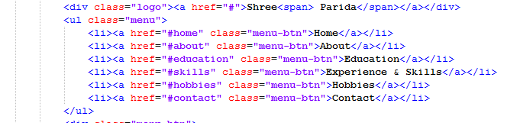
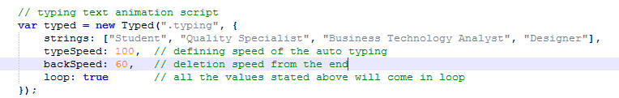
Home
Feature 1: Typing Text Animation
Feature 2: Menu list having hyperlink to respective sections
index.html
It automatically types and deletes (from end) the given value in JavaScript file at a certain speed
script.js

Slide 4
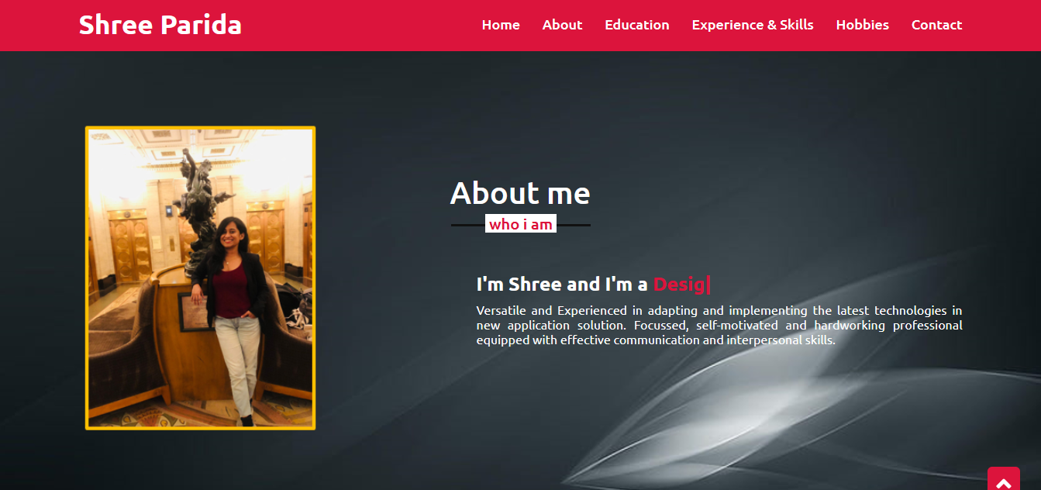
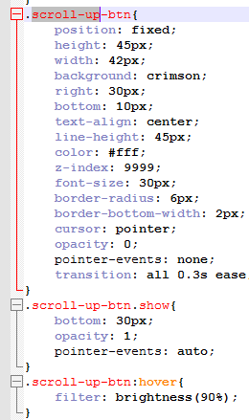
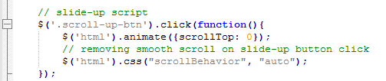
About
style.css
script.css
Feature 3: Scroll up button
On clicking it will scroll up to “Home” Page. The transition will take 0.3 secs as mentioned in style.css file
index.html

Slide 5

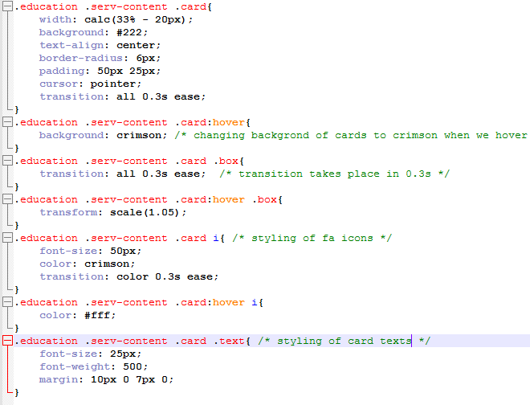
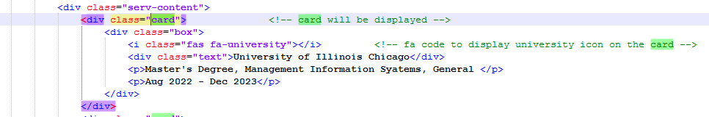
Education
Feature 5: fa code to display icon
Using class=“fas fa-school” to display the school icon for that card
style.css
Feature 4: Cards
Using the div tag to create card and box and then another div tag for university name. It also have functionality of changing background color to crimson when we hover over it
index.html

Slide 6

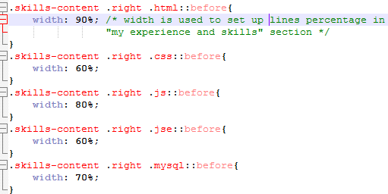
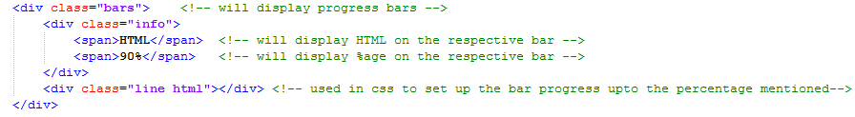
Experience and Skills
style.css
Feature 6: Percentage bar
It is just a CSS styling, filled bar shows percentage comfortability in different skills.
index.html

Slide 7
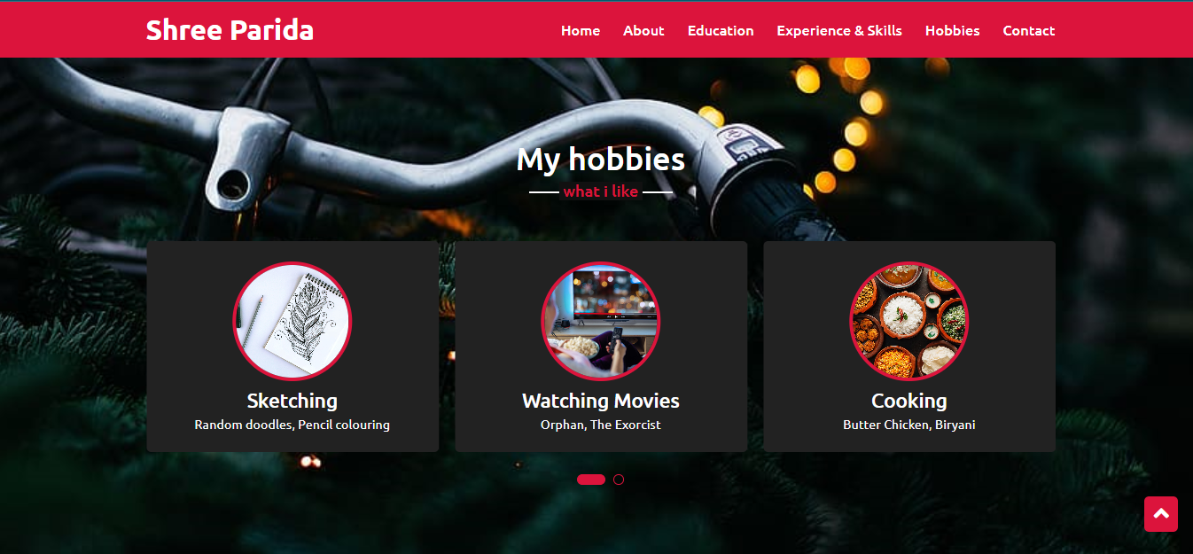
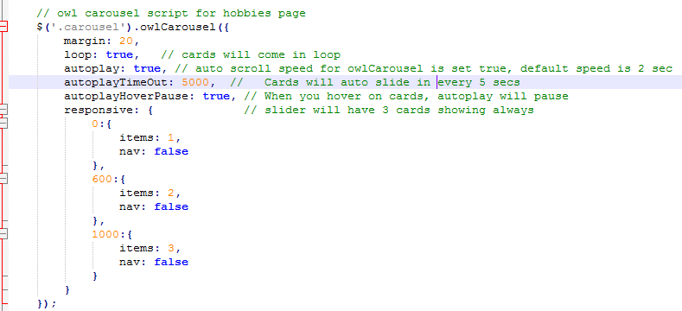
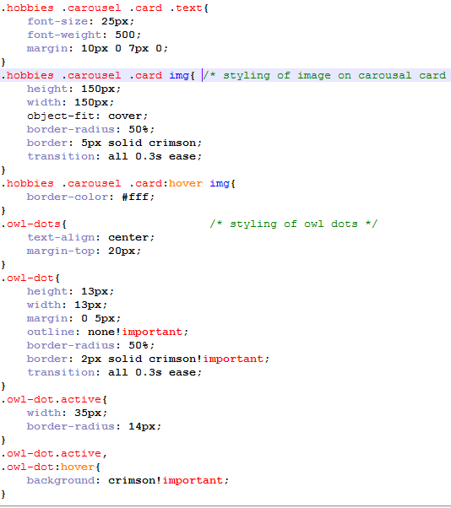
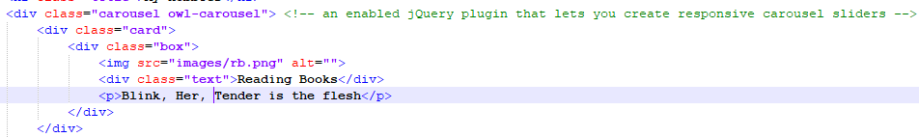
Hobbies
script.js
Feature 7: owl-carousel slider
It is an enabled jQuery plugin that lets us create responsive carousel sliders. All we need is to wrap our divs (owl works with any type of elements – a/img/span..) inside the container element. The slider will auto slide every 5 secs, when you hover over the cards, slider will pause
style.css
index.html

Slide 8
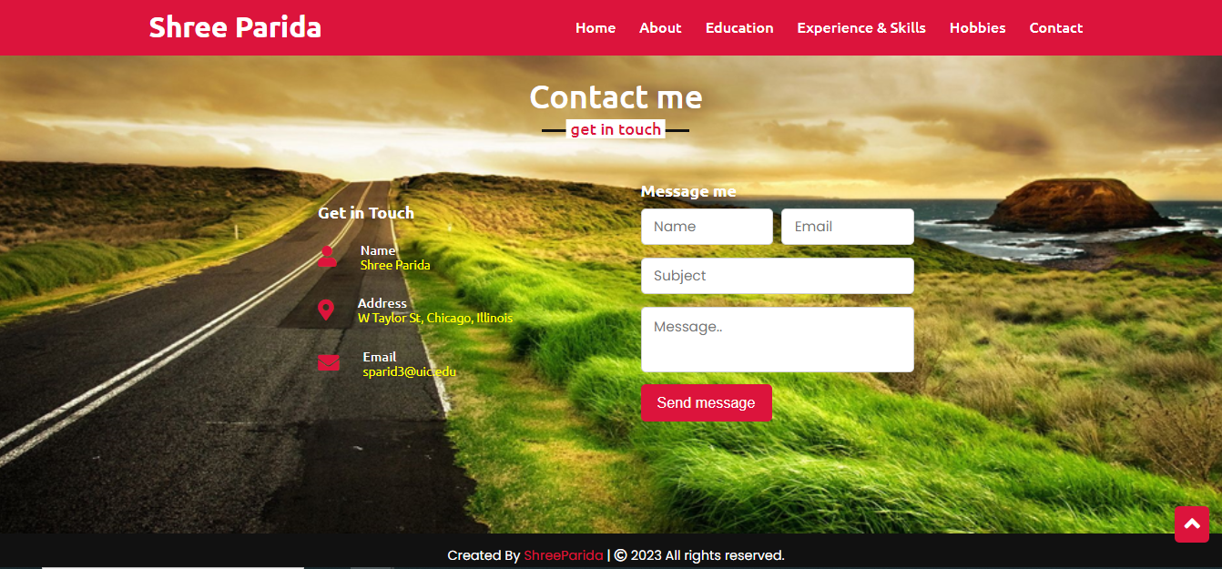
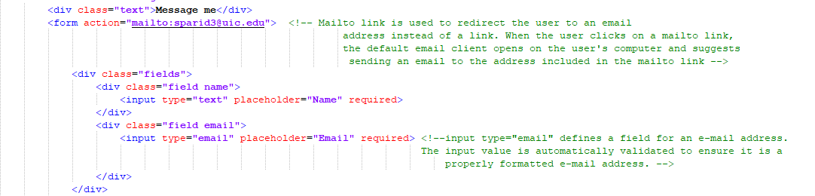
Contact
Feature 9: Mailto Action
Mailto link is used to redirect the user to an email address instead of a link. When the user clicks on a mailto link, the default email client opens on the user's computer and suggests sending an email to the address included in the mailto link
Feature 8: Email id auto validation
The input type="email" defines a field for an e-mail address. The input value is automatically validated to ensure it is a properly formatted e-mail address.
index.html

Slide 9
Thank you

